Slide 1
e-asTTle
Using e-asTTle for learners at home
Advice and support for those schools considering using e-asTTle remotely

Slide 2
Purpose
This slideshow provides advice and support for those schools considering using e-asTTle remotely with learners who are not able to attend school. The content includes advice, considerations, practical support, and guidance on how the data should be used and interpreted.
Much of the tool specific information is sourced from Help with e-asTTle.
Notes:
It is highly likely there will be huge variation in learning conditions for students in these circumstances. This could include learning spaces, access to devices and the internet, whānau support, family circumstances, and the emotional and motivational disposition of students.

Slide 3
Why use e-asTTle with learners at home?
When home learning occurs for an extended period, schools may consider collecting and using assessment information. If so, the variation in home learning conditions and the best interests of students should be significant considerations.
It is advised:
Schools should first consider if an assessment activity is appropriate and will be of value to students, teachers and whānau.
High stakes decisions should not be made from assessment data collected from home learners.
If data is collected it should be used to inform future learning, check on current learning, and provide an entry point for learning discussions with both students and whānau.
Notes:
It is highly likely there will be huge variation in learning conditions for students in these circumstances. This could include learning spaces, access to devices and the internet, whānau support, family circumstances, and the emotional and motivational disposition of students.

Slide 4
Preparation for e-asTTle with learners at home
e-asTTle has two modes of test administration, online and paper-based.
Both options will be covered in the following slides.

Slide 5
Sharing the purpose
Firstly, inform the student and whānau about the purpose of the intended testing. This should particularly focus on the low stakes nature of the assessment, and the need for teachers to get good data to understand where a student is at with his/her learning. Points to communicate to both students and whānau include:
try to complete the assessment in a quiet uninterrupted space
try hard
avoid getting assistance from others as it is your learning
don’t use the internet or other tools to work out the answers.
If this is communicated well, students are more likely to complete the assessment independently and to the best of their ability.

Slide 6
Differentiated testing
The advice for assigning tests for students at home does not differ to normal school testing.
To get the best possible data students should be given a challenging test for their current ability. This means a student will have some success, but also get some answers wrong.
To achieve this, create a group of tests of different difficulty. You can find more out about creating effective tests here.
You may consider reducing the test time for tests at home. For example, if you normally create 45-minute tests, you may find you get more dependable results for home-based testing by only setting 30-minute tests.
*** Please note that not every teacher needs to make tests. If a teacher or a small group of teachers make a set of tests they can be used by any teacher within your school. This is far more efficient and better for collating data than everyone making their own set of tests.
Notes:
https://easttlehelp.vln.school.nz/create-test/guidelines-for-creating-good-custom-and-adaptive-tests

Slide 7
Customised or adaptive tests?
Customised tests are normally recommended over adaptive tests as they:
provide greater control over test creation
they tend to generate more dependable results
provide more information to a teacher as all questions can be seen both prior to and after testing.
Customised testing is also a good option if you want to control when the reports are seen.
Reports will only be viewable once all open-ended questions are marked by the teacher.
If you want students to see their results straight away, adaptive testing will enable this as only closed questions are asked.

Slide 8
Checking access to e-asTTle
It is assumed you already know about individual student access to the internet and devices. There is guidance on suitable devices here.
If some students do not have sufficient device or internet access, you may wish to consider paper-based testing.
An online customised test can be converted to a paper-based test. Guidance for converting and online test to paper can be found here.
Notes:
https://easttlehelp.vln.school.nz/uncategorized/device-requirements
https://assessment.tki.org.nz/Media/Files/DEF-files/e-asTTle-8.6.0-enhancements-October-2019

Slide 9
Student passwords
If testing online, all students will need access to log in at this address:
https://e-asttle.education.govt.nz/StudentWeb/login
Students will need to know their own username and password.
This information should be shared individually with students
If passwords are current and known it is just a matter of checking, prior to testing, that all students can log in.
If passwords are not known or expired, then resetting of passwords is required. Information on resetting student passwords can be found here.
The e-asTTle student login page
Notes:
https://easttlehelp.vln.school.nz/manageimport-students/test/resetting-student-passwords

Slide 10
Naming tests
Name your tests well so other teachers and students can easily find and identify them
The name of the test will need to be shared with students so they can easily identify the correct test to sit.
You may wish to include something like ‘@H’ as part of the test name to indicate this was administered while the students were learning from home. An example can be seen below:
PSIdL34Mar22@H
(Processes and strategies, Ideas, Mainly level 3 and 4, sat in March 22, @ home)

Slide 11
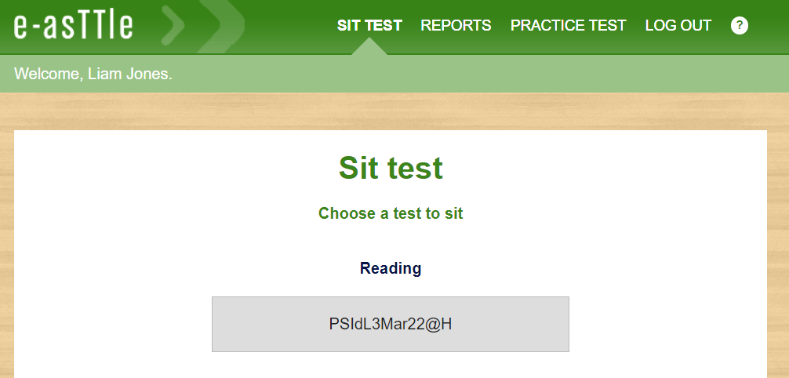
Assigning tests
The process for assigning students who are working from home does not differ to those at school.
When the student logs in, the assigned test will be viewable and available for sitting if within the testing window.

Slide 12
Options for when testing can be done
You will need to consider an appropriate deadline for all students to complete the test. This is a particularly important consideration for students learning from home as a longer time may be needed for those with limited access to technology.
This can be determined in the ‘Assign test’ area of e-asTTle, as per the image below.
Notes:
Once the assignment time expires, the test will no longer be available for students to sit unless you reassign it.

Slide 13
Options for when testing can be done
You can opt to make tests available at three different times. They are:
Anytime – the test can be taken at anytime
Weekdays – the test is only available for students to take from Monday to Friday
School hours – the test can only be taken between the hours of 8:30am and 4:00pm
Testing early in the day is normally optimal, but this may not be possible for some home-based students.
For students based at home you may wish to give greater flexibility for when the students can take the test – i.e. anytime.

Slide 14
Practice tests
Students should be familiar with e-asTTle online testing environment.
It is not recommended students sit an e-asTTle test online for the first time while learning at home.
Students should have the opportunity to reacquaint themselves with how an e-asTTle test works by going through the appropriate practice test, which can be found on the student login page.
Using the practice tests increases the chance of dependable data because it eliminates lack of knowledge of the online environment as a factor.
Notes:
https://training.e-asttle.education.govt.nz/StudentWeb/practice-test-subject.faces

Slide 15
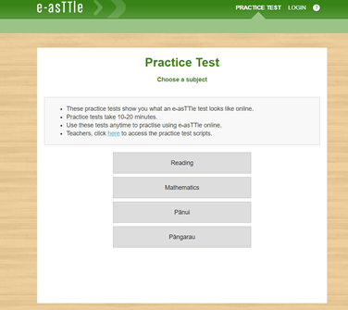
Practice tests
The practice test familiarises students with scrolling, navigating, and submitting their answers, while also giving them a chance to practice the different ways of answering questions.
It is a good way to check if an e-asTTle test is going to work on each student’s device and/or browser.
Idea:
Teachers could share a screen on a video conference call with their students, to explain and model the testing process.
Students could then have a go at the practice test themselves prior to testing.

Slide 16
Paper-based testing
Paper-based testing may be required if:
you are wanting the students to complete an e-asTTle writing test
online testing for reading and mathematics is not possible.
If paper-based testing is the best option for some students, there are important administrative issues to consider. This includes:
A solution for getting scripts or test papers to students, and then returned for marking will need to be developed and communicated prior to testing. For example, the school could deliver them by post with return envelopes.
Timing the test is an important aspect to consider. The online testing method has time control, but paper-based testing would rely on self-monitoring of this by the student and his/her whānau.

Slide 17
e-asTTle Writing
Things to consider if attempting to do an e-asTTle writing script with students at home.
The student booklet may not need to be printed as students could do this in a book, or on pad paper.
Students will still need access to the attitude questions and the prompt. The prompt could be shared electronically with the student. While this is not standardised procedure, it may be the most practical way of providing access to the prompt.
If the prompt has a photograph, please make sure it is shared in colour.
Notes:
Using devices to create scripts - If you are considering this, please get students to use simple word processing software such as Notepad or Text Edit as they do not have the error identification and autocorrect features available in other word processing software. When marking computer generated scripts you will have to agree on marking all incorrect words as spelling errors rather than typos and agree on things such as how paragraphs are indicated.

Slide 18
e-asTTle Writing
Things to consider if attempting to do an e-asTTle writing script with students at home.
Allow time to work through the prompt together will need to be included in your planning. This allows time for oral brainstorming etc. This could happen in a group conference call.
Students should be timed and monitored when developing their writing sample. The assessment requires up to 40 minutes of writing time, plus an additional five to ten minutes to consider the prompt and do some brainstorming. Schedule a time when the students will be uninterrupted for this length of time.
Students could do their writing on a device, but this is not a standardised approach to e-asTTle writing and not recommended. Please see the notes section on this slide for advice around this.
Notes:
Using devices to create scripts - If you are considering this, please get students to use simple word processing software such as Notepad or Text Edit as they do not have the error identification and autocorrect features available in other word processing software. When marking computer generated scripts you will have to agree on marking all incorrect words as spelling errors rather than typos and agree on things such as how paragraphs are indicated.

Slide 19
Advice for whānau and caregivers

Slide 20
Advice for whānau and caregivers
If your child has been asked to attempt an e-asTTle test while at home, please support this so your child and the teacher have the best possible information about his/her learning and progress.

Slide 21
Preparing for the test
Online testing:
Take the practice test. This helps your child become familiar with e-asTTle and is a good way to check e-asTTle is going to work on his/her device. It is quick and does not require any log ins.
Make sure the browser window is fully maximised or there may be issues viewing the test.
Get logged on and change the password if necessary. Save the password somewhere so it can be accessed later if your child forgets it.
Have the device plugged in or fully charged.
Find an appropriate place to take the test. This should be a place where it is relatively quiet so the test can be taken uninterrupted.
Keep your child relaxed. While it is important for him/her to try their best, remind them it is just a check in to see how he/she is going and to help the teacher plan for future learning.
Notes:
https://e-asttle.education.govt.nz/StudentWeb/practice-test-subject.faces

Slide 22
Preparing for the test
Paper-based testing:
Make sure your child has the correct stationery for the test, and even some spares. This may include pens, pencils, rulers, and erasers.
If the strands tested in mathematics are Measurement, Shape, or Position, orientation and transformation, please make sure your child has a ruler for measuring. It may not be needed but some questions do require the use of a ruler.
Have sufficient light to be able to read and write without issues.
If possible, have some spare paper so your child can do workings or planning.
Have a clock or timer available so your child can see how much time is left. Phones have a timer function which may be handy.

Slide 23
During the test
Don’t help with questions. Helping your child means they may miss out on important learning as it can be assumed they know something they don’t. This is his/her learning and only accurate information on what they can and can’t do is useful for future learning.
Minimise interruptions during testing time.
Support your child to use the time fully. If there are unanswered questions, encourage him/her to go back and try to answer them. Don’t encourage guessing as it is not useful for your child’s learning, but other strategies may help them get to an answer.
Keep your child calm no matter what happens. Teachers can reassign a test and/or eliminate results if something goes badly wrong.

Slide 24
During the test
Online testing:
If there are warnings about internet connections or some other issue, please follow the troubleshooting advice here. The main thing to remember if there are issues is don’t refresh the browser page or close the window as data that has not been saved will be lost.
Make sure the submit button is clicked at the conclusion of the test so the result is captured by e-asTTle.
Try to minimise other internet use across your home. This will reduce the likelihood of connection issues.
Notes:
https://easttlehelp.vln.school.nz/studentwebsite/troubleshooting

Slide 25
During the test
Paper-based testing:
Keep to time and stop your child after the set time. Do not give longer than allowed unless you have specific instructions from his/her teacher to do so.
Give them some prompts around time keeping – e.g. “You have five minutes left”.
Make sure your child is filling the paper test form in correctly. For example, for multi choice questions it only requires shading of the circle next to the answer he/she thinks is best.
Provide more spare paper if needed.

Slide 26
After the test
Online testing:
Discuss how the test went. What went well? What was hard? Were there any technical issues?
Contact the teacher if there were issues that may have adversely affected your child’s result. This is valuable information to share.
Spend time looking at the student Individual Learning Pathway with your child if this is encouraged by the teacher. This link can help explain how to interpret the information.
Notes:
https://easttlehelp.vln.school.nz/reports/understanding-the-individual-learning-pathway-ilp

Slide 27
After the test
Paper-based testing:
Make sure your child’s name is on the test
Don’t change any answers or choices.
Make a note on the front of the test paper if there were any disruptions or events that may have had an adverse effect on your child’s result.
Make sure choices or answers are clear for the teacher. For example, your child may have changed his/her mind on a multi choice question and may not have erased or crossed out the first choice very well. By rubbing out or putting a big cross through that option the teacher will clearly see which option was chosen. A teacher would normally ask your child about this if he/she was at school, but may not have that luxury if the student is learning from home.
Follow the arrangements for getting it back to the teacher – e.g. placing in an envelope and posting.

Slide 28
Interpreting the results

Slide 29
An important consideration
Remember that learning conditions may have been quite different across the group of students and could have adversely affected the overall result for some students.
The conditions for testing should be considered as a factor for results that are surprising or challenging.
Interpretations and decisions made from this data should be low stakes and mainly formative.

Slide 30
Confirm or challenge?
Does the result confirm or challenge what you already know about this student?
If it confirms what you know, you can have a reasonable level of trust in the result.
If it challenges your knowledge of the student, consider what is challenging about the result and how likely it is that your perception may be wrong.

Slide 31
What if things go wrong for the student?
If a result is not representative of a student’s ability, you may consider eliminating the result from the student’s e-asTTle records.
This would normally occur if there has been a disturbance of some kind (interruption, illness etc.) and the test time was completed.
Student exclusions are available within e-asTTle so a specific score can be deleted from the student’s result summary within e-asTTle. You can find out more about student exclusions here.
Notes:
https://easttlehelp.vln.school.nz/assign-test/student-exclusions

Slide 32
Share don’t give
If possible, spend time discussing the test results with students and/or whānau.
Experience has shown that giving e-asTTle reports to whānau members without support is not useful.
The Individual Learning Pathway and the Individual Question Analysis are two reports that can generate mutually beneficial learning conversations with students and/or whānau.
To make this possible, teachers must have confidence with interpreting results. The diagram on the next slide is helpful in supporting teachers to make sense of the Individual Learning Pathway, the Individual Questions Analysis, and the Group Learning Pathway.

Slide 33
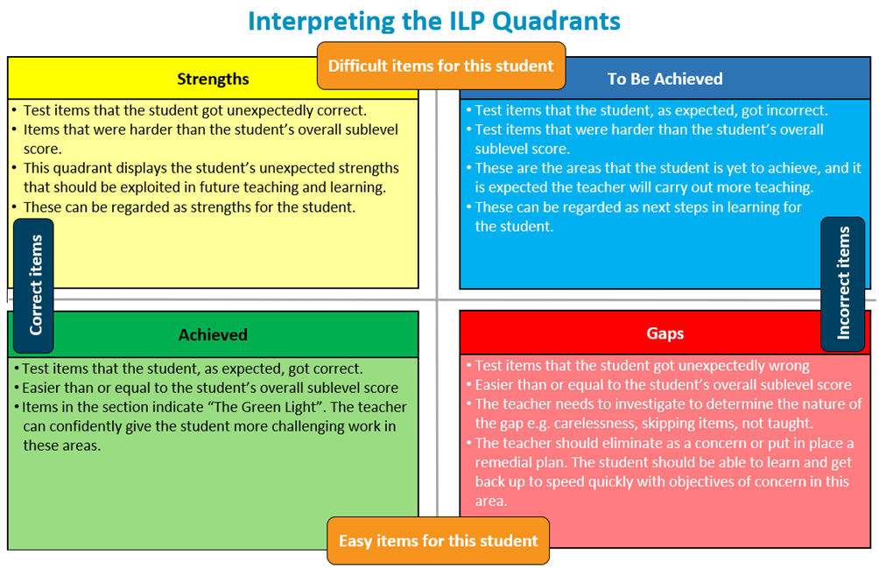

Slide 34
Need support?
Evaluation Associates | Te Huinga Kākākura Mātauranga can provide ministry funded support directly to you or your staff.
If you need support with using e-asTTle, particularly if considering using it with learners at home, please contact us at info@evaluate.co.nz and someone will be in touch.

